Slide 1
Spring Boot Framework-
Part-1
21CSE354T – FSWD_UNIT 3

Slide 2
Spring Boot Framework-Part-1: Basic concepts: Spring, Spring Boot, Testing Basics, Testing in Spring Boot. A Basic Spring Boot Application: Setting up the Development Environment, The Skeleton Web App, Spring Boot Auto configuration, Three-Tier, Three-Layer Architecture, Modeling our Domain, Business Logic, Presentation Layer.

Slide 3
BASIC CONCEPT
Spring is the most popular application development framework for enterprise Java. Spring Framework is used to create high performing, easily testable, and reusable code.
Spring framework is an open-source Java platform. It was initially written by Rod Johnson and was first released under the Apache 2.0 license in June 2003.
The Spring Framework is a vast set of libraries and tools simplifying software development, namely, dependency injection, data access, validation, internationalization, aspect-oriented programming, etc.
It’s a popular choice for Java projects, and it also works with other JVM-based languages such as Kotlin and Groovy.

Slide 4
SPRING
Spring is so popular that it saves a lot of time by providing built-in implementations for many aspects of software development, such as the following:
Spring Data simplifies data access for relational and NoSQL databases.
Spring Batch provides powerful processing for large volumes of records.
Spring Security is a security framework that abstracts security features to applications.
Spring Cloud provides tools for developers to quickly build some of the common patterns in distributed systems.
Spring Integration is an implementation of enterprise integration patterns. It facilitates integration with other enterprise applications using lightweight messaging and declarative adapters.

Slide 5
SPRING
Spring is divided into different modules.
All of the modules are built on top of the core Spring Framework, which establishes a common programming and configuration model for software applications.
This model itself is another important reason to choose the framework since it facilitates good programming techniques such as the use of interfaces instead of classes to decouple application layers via dependency injection

Slide 6
SPRING BOOT
Spring Boot is a framework that leverages Spring to quickly create stand-alone applications in Java-based languages.
It has become a popular tool for building microservices.
Having so many available modules in Spring and other related third-party libraries that can be combined with the framework is powerful for software development.
Yet, despite a lot of efforts to make Spring configuration easier, you still need to spend some time to set up everything you need for your application.
And, sometimes, the same configuration is required over and over again.

Slide 7
SPRING BOOT
Bootstrapping an application, meaning the process to configure your Spring application to have it up and running, is sometimes tedious.
The advantage of Spring Boot is that it eliminates most of that process by providing default configurations and tools that are set up automatically for you.
The main disadvantage is that if you rely too much on these defaults, you may lose control and awareness of what’s happening.

Slide 8
SPRING BOOT
Spring Boot provides some predefined starter packages that are like collections of Spring modules and some third-party libraries and tools together.
  Example: spring-boot-starter-web helps you build a stand-alone web application. It groups the Spring Core Web libraries with Jackson (JSON handling), validation, logging, autoconfiguration, and even an embedded Tomcat server, among other tools.
autoconfiguration plays a key role in Spring Boot. This feature makes adding functionality to your application extremely easy.
  Following the same example, just by including the web starter, you will get an embedded Tomcat server. There’s no need to configure anything. This is because the Spring Boot autoconfiguration classes scan your classpath, properties, components, etc., and load some extra beans and behavior based on that.

Slide 9
SPRING BOOT
To be able to manage different configuration options for your Spring Boot application, the framework introduces profiles. You can use profiles, for example, to set different values for the host to connect to when using a database in a development environment and a production environment.
Additionally, you can use a different profile for tests, where you may need to expose additional functions or mock parts of your application.

Slide 10
Testing Basics
Test-Driven Development
This technique helps in putting the focus first on what you need and what your expectations are and later moving to the implementation.
It makes the developer, think what the code should do under certain situations or use cases.
Behavior-Driven Development (BDD)
BDD brings some better structure and readability to your tests.
In BDD, tests are written according to a Given-When-Then structure.
This removes the gap between developers and business analysts when mapping use cases to tests. Analysts can just read the code and identify what is being tested there
BDD, like TDD, is a development process by itself and not simply a way of writing tests. Its main goal is to facilitate conversations to improve the definition of requirements and their test cases.

Slide 11
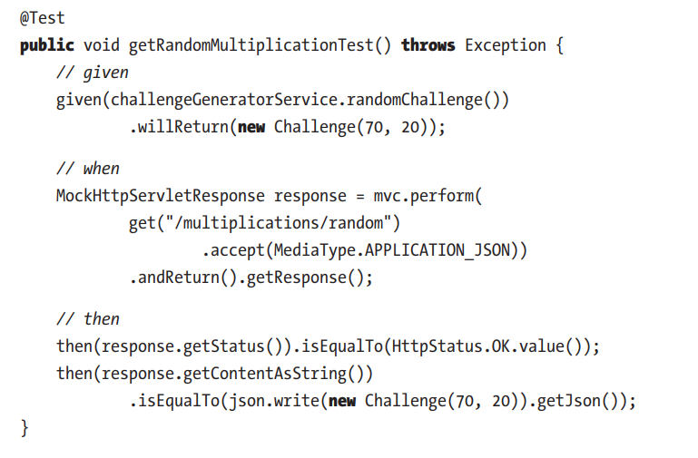
An Example of a BDD Test Case Using a Given-When-Then Structure

Slide 12
Testing Basics
JUnit
Unit tests are used to verify the behavior of your classes (units) separately.
Main features in JUnit 5 listed here:
@BeforeEach and @AfterEach for code that should be executed before and after each test, respectively.
@Test for every method that represents a test we want to execute.
@ExtendsWith at the class level to add JUnit 5 extensions.
Mockito
Mockito is a mocking framework for unit tests in Java.
When you mock a class, you are overriding the real behavior of that class with some predefined instructions of what their methods should return or do for their arguments.
This is an important requirement to write unit tests since you want to validate the behavior of one class only and simulate all its interactions.
The easiest way to mock a class with Mockito is to use the @Mock annotation in a field combined with MockitoExtension for JUnit 5

Slide 13
Testing Basics
AssertJ
The standard way to verify expected results with JUnit 5 is using assertions.
assertEquals("Hello, World!", actualGreeting);
There are not only assertions for equality of all kinds of objects but also to verify true/false, null, execution before a timeout, throwing an exception, etc.
You can find them all in the Assertions Javadoc (https://tpd.io/junit-assert-docs).

Slide 14
Testing in Spring Boot
Both JUnit 5 and AssertJ are included in spring-boot-starter-test, so only need to include this dependency in our Spring Boot application to make use of them. Then, we can use different testing strategies.
Best way to write tests in Spring Boot is to make use of the @SpringBootTest annotation. It will start a Spring context and make all your configured beans available for the test.
When testing specific slices or individual classes of your application, it’s better to use plain unit tests (without Spring at all) or more fine-grained annotations like @WebMvcTest, focused on controller-layer tests.

Slide 15
Testing in Spring Boot
Integration between the libraries and frameworks
The Spring Test libraries (included via Spring Boot Test starter) come with a SpringExtension so you can integrate Spring in your JUnit 5 tests via the @ExtendWith annotation.
The Spring Boot Test package introduces the @MockBean annotation that we can use to replace or add a bean in the Spring context, in a similar way to how Mockito’s @Mock annotation can replace the behavior of a given class. This is helpful to test the application layers separately so there is no need to bring all your real class behaviors in your Spring context together

Slide 16
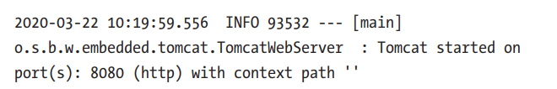
Testing in Spring Boot - Logging
In Java, we can log messages to the console just by using the System.out and System.err print streams.
System.out.println("Hello, standard output stream!");
Most professional Java apps use a logger implementation such as LogBack. There are multiple logging frameworks for Java, it’s even better to choose a generic abstraction such as SLF4J.
The good news is that Spring Boot comes with all this logging configuration already set up for us. The default implementation is LogBack, and Spring Boot’s preconfigured message format is as follows:

Slide 17
A Basic Spring Boot Application

Slide 18
The Skeleton Web App
Spring offers a fantastic way to build the skeleton of an application: the Spring Initializr
This is a web page that allows us to select what components and libraries we want to include in our Spring Boot project, and it generates the structure and the dependency configuration into a zip file that we can download.
Source Code: chapter03 You can find all the source code for this chapter on GitHub, in the chapter03 repository. See https://github.com/Book-Microservices-v2/chapter03.

Slide 19
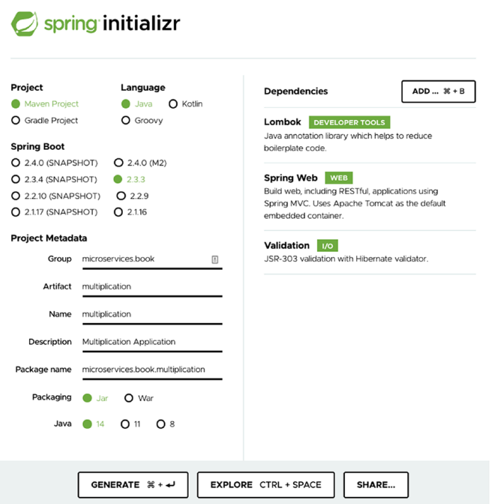
Let’s navigate to https://start.spring.io/ and fill in some data, as shown in Figure 3-1
Creating a Spring Boot project with the Spring Initializr

Slide 20
Give some values to the group (microservices.book) and the artifact (multiplication).
Select Java 14.
Do not forget to add the dependencies Spring Web, Validation, and Lombok from the list or search tool
Generate the project and extract the ZIP contents.
The multiplication folder contains everything you need to run the application.
You can now open it with your favorite IDE, usually by selecting the pom.xml file.

Slide 21
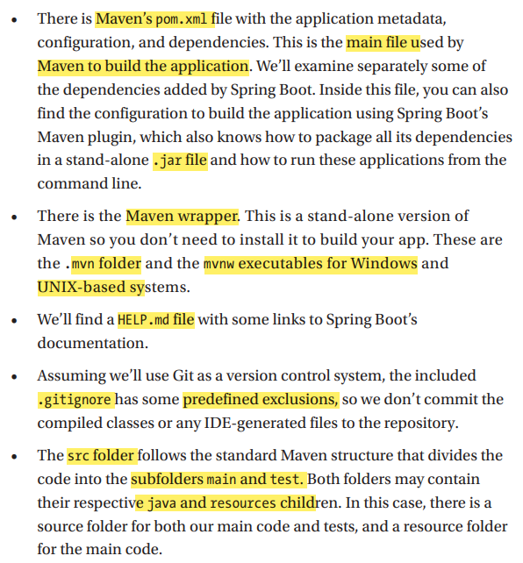
These are the main elements we’ll find in the autogenerated package

Slide 22
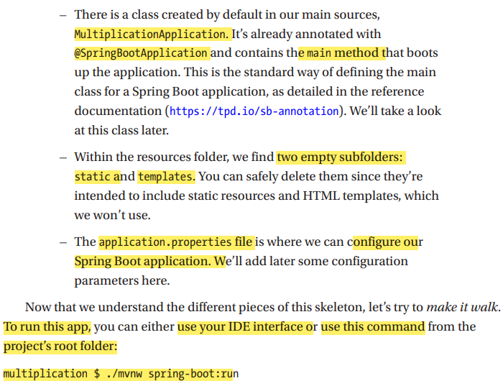

Slide 23
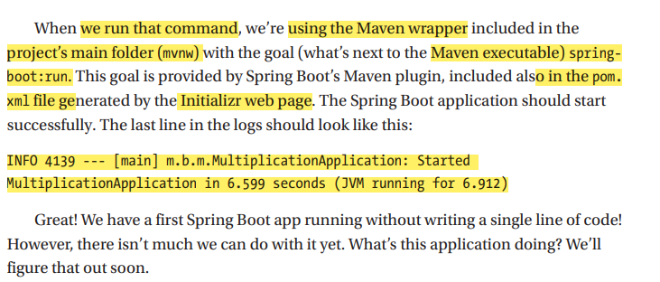

Slide 24
Spring Boot Autoconfiguration
In the logs of our skeleton app, you can also find this log line:
INFO 30593 --- [main] o.s.b.w.embedded.tomcat.TomcatWebServer: Tomcat initialized with port(s): 8080 (http)
What we get when we add the web dependency is an independently deployable web application that uses Tomcat, thanks to the autoconfiguration feature in Spring.
Spring Boot sets up libraries and default configuration automatically.

Slide 25
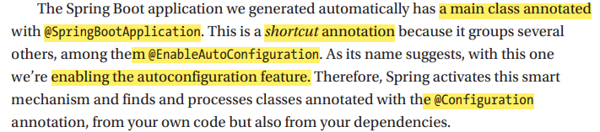

Slide 26
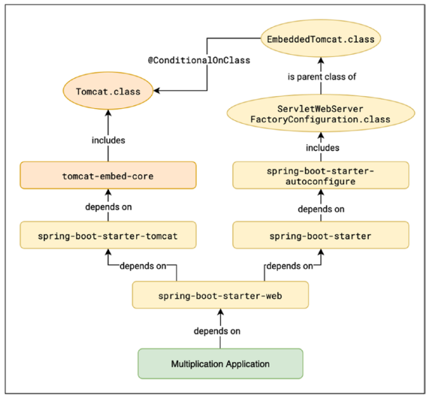
Autoconfiguration example: embedded Tomcat

Slide 27
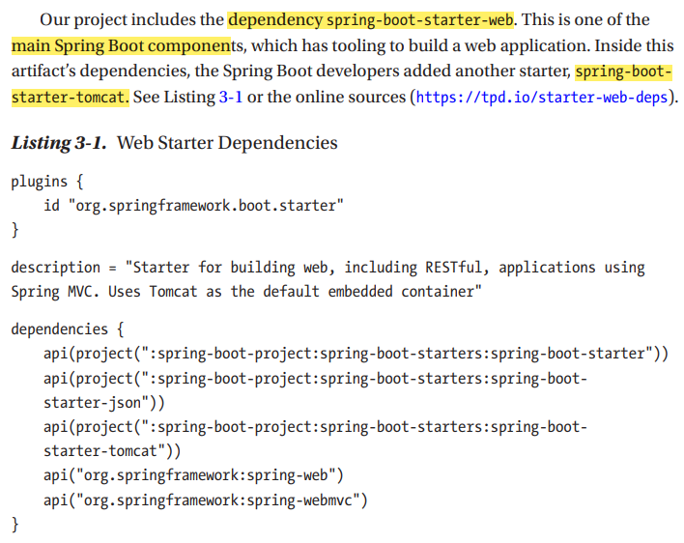

Slide 28
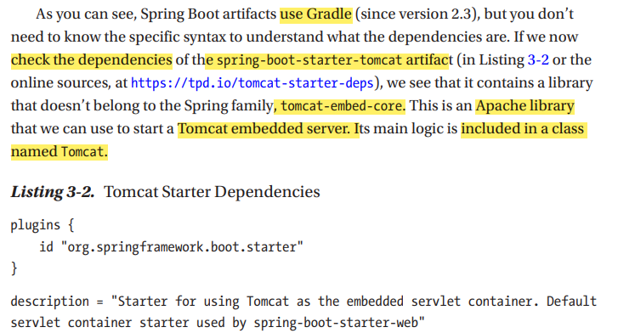
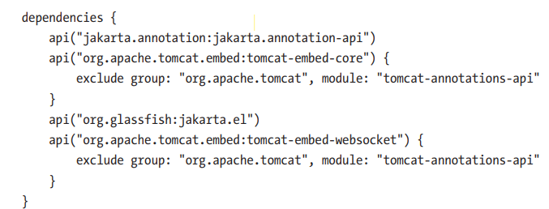

Slide 29
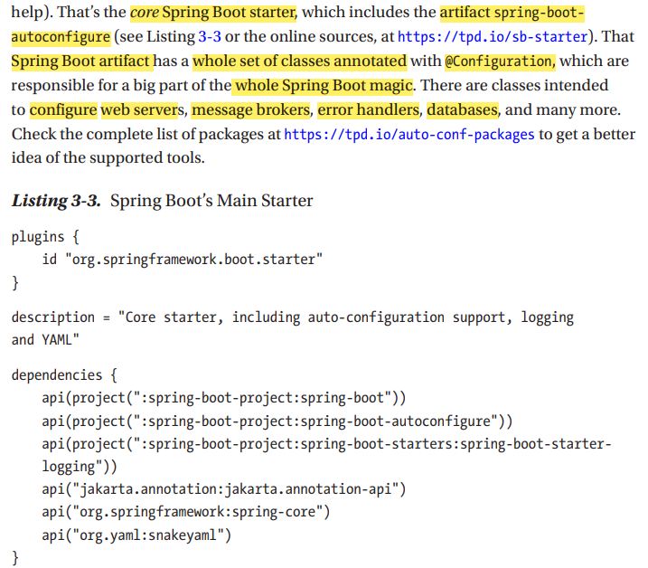

Slide 30
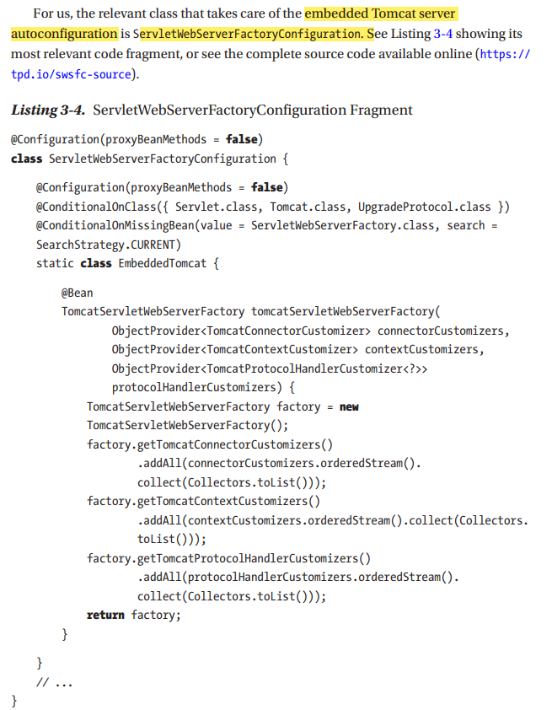

Slide 31
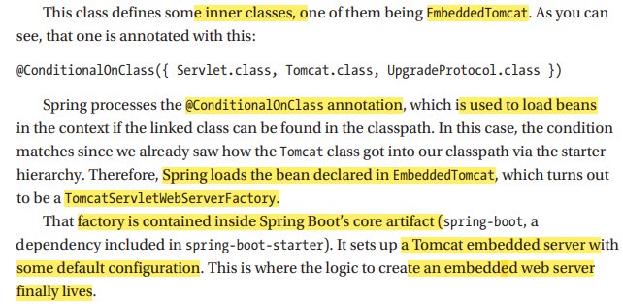

Slide 32
Three-Tier, Three-Layer Architecture
These three tiers are as follows:
Client tier: This tier is responsible for the user interface. Typically, this is what we call the front end.
Application tier: This contains all the business logic together with the interfaces to interact with it and the data interfaces for persistence. This maps to what we call the back end.
Data store tier: It’s the database, file system, etc., that persists the application’s data.

Slide 33
Application tier is commonly designed using three layers.
Business layer: This includes the classes that model our domain and the business specifics. It’s where the intelligence of the application resides. Sometimes this layer is divided into two parts: domains (entities) and applications (services) providing business logic.
Presentation layer: In our case, it will be represented by the Controller classes, which will provide the functionality to the web client. Our REST API implementation will reside here.
Data layer: This layer will be responsible for persisting our entities in a data storage, usually a database. It can typically include data access object (DAO) classes, which work with objects that map directly to rows in a database, or repository classes, which are domain-centric, so they may need to translate from domain representations to the database structure

Slide 34
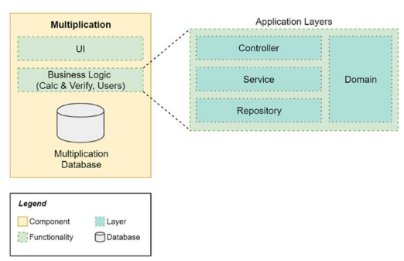
Our goal is now to apply this pattern to the Multiplication web application
Three-tier, three-layer architecture applied to our Spring Boot project

Slide 35
The advantages of using this software architecture are all related to achieving loose coupling.
All layers are interchangeable (such as, for instance, changing the database for a file storage solution or changing from a REST API to any other interface). This is a key asset because it makes easier to evolve the codebase.
The domain part is isolated and independent of everything else. It’s not mixed with interface or database specifics.
There is a clear separation of responsibilities: a class to handle database storage of the objects, a separate class for the REST API implementation, and another class for the business logic.

Slide 36
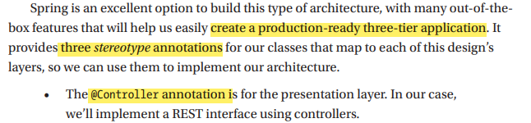


Slide 37
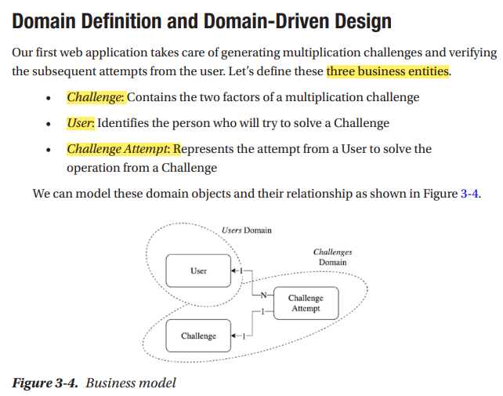
Modeling Our Domain

Slide 38
The relations between these objects are as follows:
Users and Challenges are independent entities. They don’t keep any references.
Challenge Attempts are always for a given user and a given Challenge. Conceptually, there could be many attempts for the same Challenge, given that there is a limited number of generated challenges.

Slide 39
Users and Challenges. Finding domain boundaries (also known as bounded contexts; see https://tpd.io/bounded-ctx) and defining relations between your objects are essential tasks of designing software.
This design approach based on domains is called domain-driven design (DDD). It helps you build an architecture that is modular, scalable, and loosely coupled.
For instance, we could introduce social network features by creating the domain Friends and modeling relationships and interactions between users.

Slide 40
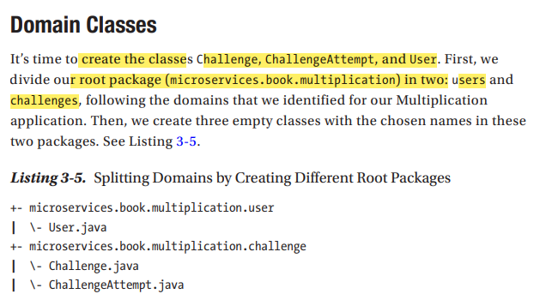

Slide 41
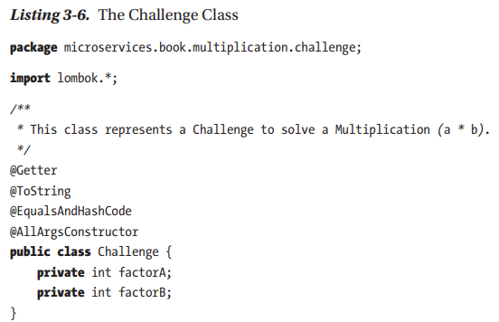
The Challenge class holds both factors of the multiplication. We add getters, a constructor with all fields, and the toString(), equals(), and hashCode() methods. See Listing 3-6.

Slide 42
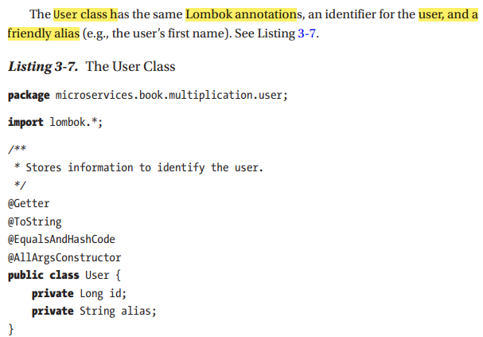

Slide 43
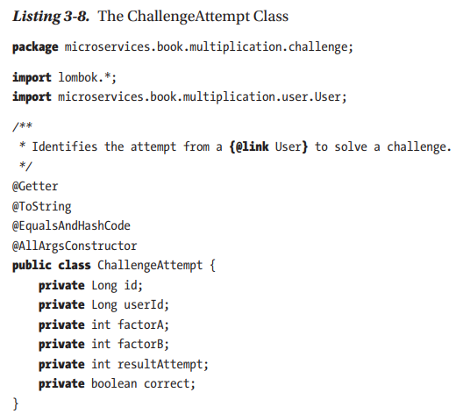
Attempts also have an id, the value input by the user (resultAttempt), and whether it’s correct or not.
We link it to the user via userId.
We do this to avoid having a reference to a challenge via challengeId because we can simply generate new challenges “on the fly” and copy them here to keep our data structures simple

